Slide 1
Meta Learning Learning to Learn in Neural Network
Student ID: 014530243
Name: Atul Shah

Slide 2
Meta Learning Fundatmentals
2 Levels of Learning: Inner and Outer algorithm.
Inner learning is similar to conventional learning algorithm such as improving image classification.
Outer algorithm updates the inner learning algorithm, such that the model learned by the inner algorithm improves an outer objective.

Slide 3
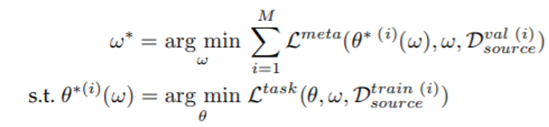
Equation
L: a function that measures the match between true labels and those predicted by
θ: parameter for inner algorithm D: the dataset under consideration ω: meta-knowledge to make explicit the dependence of this solution on factors such as choice of optimizer for θ or function class for f, which we denote by ω.

Slide 4
Taxonomy
Meta-Representation
Based on representation of meta-knowledge ω. This includes estimation of model parameters used for optimizer initialization.
Meta-Optimizer
Based on choice of optimizer to use for the outer level during meta-training. Examples: gradient-descent, reinforcement learning and evolutionary search.
Meta-Objective
Based on the goal of meta-learning and choice of meta objective.

Slide 5
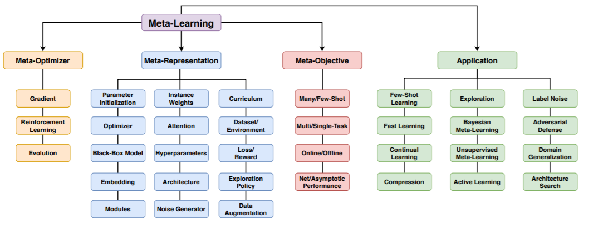
Taxonomy

Slide 6
Applications
Computer Vision and Graphics
Meta Reinforcement Learning and Robotics
Environment Learning and Sim2Real
Neural Architecture Search
Continual, Online and Adaptive Learning

Slide 7
Challenges
Mutli-modality
Most algorithms assume unimodal task distribution but in reality most domains have multi-modality distributions.
Computation Cost
Quadratic learning steps require more memory and time.
Cross-modal transfer and heterogeneous tasks
To be able to able to extract knowledge from set of tasks each having its own modality and transfer it into another task with a unique modality is an open challenge.

